Slide 1

Music Buddy

Slide 2

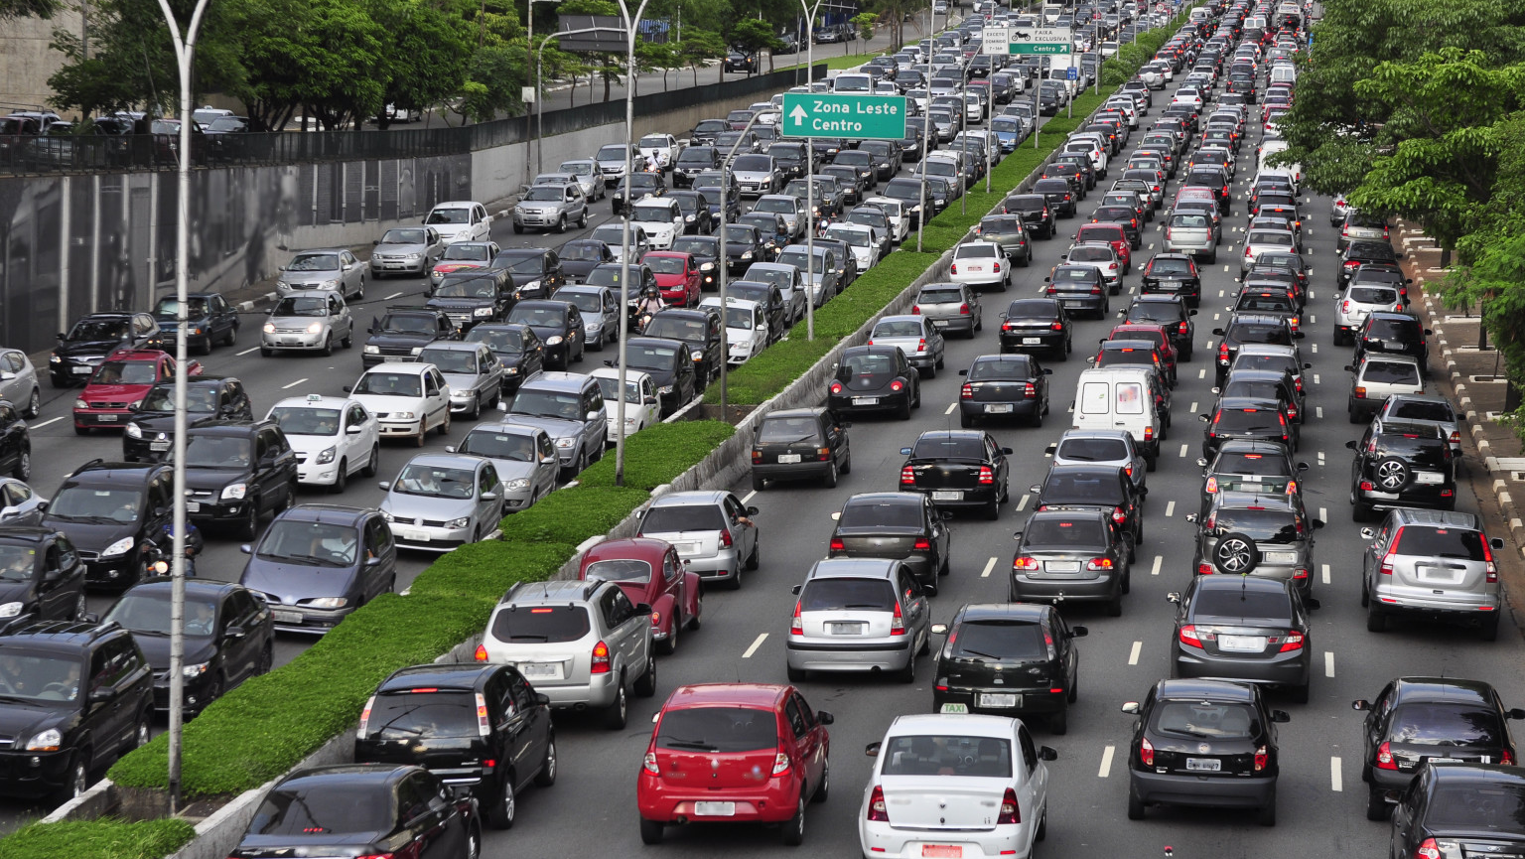
45 mins to Home ??

Slide 3

Playlists have songs you don’t like !!

Slide 4
UNDERSTANDING PAINPOINTS

Slide 5

MEET BRIAN
BIO
22, Student – Graphics designer
Lives in Seattle with his roommate
Social media buff
shares his likes and dislikes,
Extrovert, loves to have followers, looks for cool factor
Music lover
PAIN POINT
“ Music apps don’t have good social integration. I have to wait for the weekend to meet my friends and talk about what we like and dislike. We might message and tell “Hey buddy check out this song” but that’s it !”

Slide 6

MEET JANE
BIO
18, Art Student lives in Sunnyvale with her parents.
Spends lot of time on Social media
Introvert, rarely shares her opinion publicly.
Music lover, does her Art work while listening to music.
Music is a very private experience for her, she believes people might judge her for her choices.
Loves creating memories.
PAIN POINT
Being an introvert she has a hard time getting in person music recommendations from friends. Usually lag behind in knowing what is trending in her group. She doesn’t have time to create playlists.

Slide 7
UNDERSTANDING FACEBOOK

Slide 8

Facebook’s MISSION
“Give people the power to build community and bring the world closer together”

Slide 9

INTRODUCING FACEBOOK’s MUSIC BUDDY !!

Slide 10

IT’s A MUSIC PLATFORM
Something for everyone – creators and users
CREATORS socialize and recognition
USERS get recommendation and save time !!

Slide 11

Is It worth it ?? Let’s explore music industry …

Slide 12
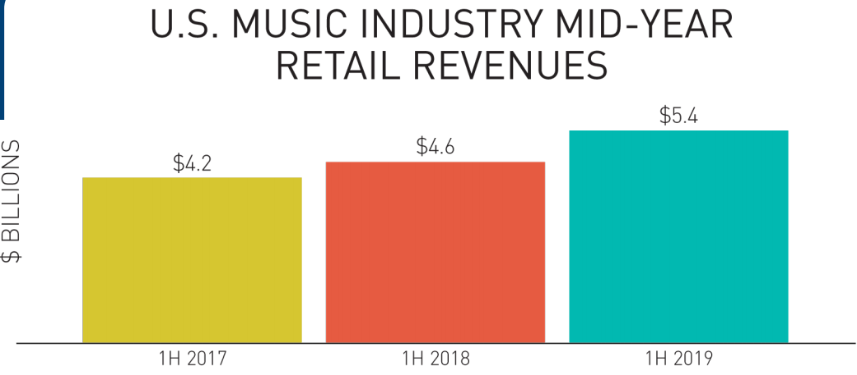
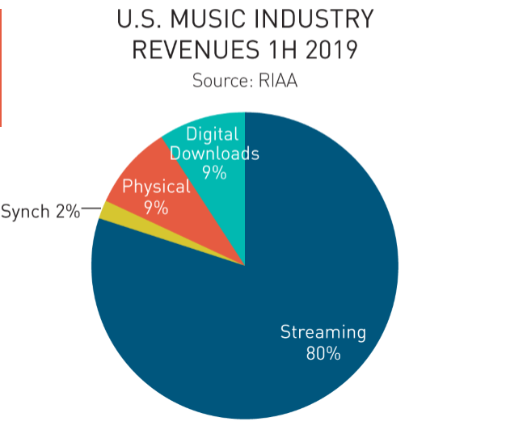
MUSIC INDUSTRY TODAY
Streaming Music Industry in US as of 2019 – 4.3 B USD
*Source: RIAA (Recording Industry Association of America)

Slide 13
INTERESTING FACTS
US Population 300 M
Internet users 293 M*
Facebook users 169 M*
Paid Music Subscribers
61 M*
77%(230M) of Americans listen to music actively around 25 hour per week.*
~61M people who listen to music are not on Facebook
At least 100M Facebook users are currently not subscribed to paid music
*In US as of 2019.Refer appendix

Slide 14
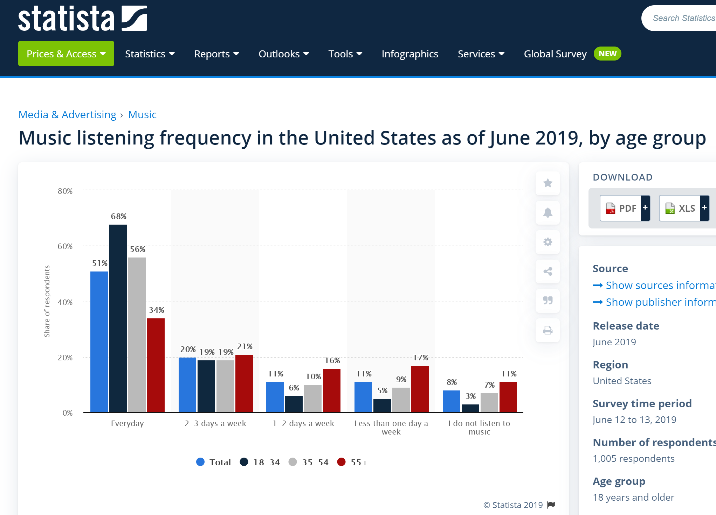
HOW FREQUENTLY PEOPLE LISTEN TO MUSIC BY AGE
https://www.statista.com/statistics/749666/music-listening-habits-age-usa/

Slide 15

REVENUE MODEL
AD BASED FREE MUSIC + Paid Subscriptions
AD BASED FREE MUSIC:-
2 Ads together per half hour ( 4 ads per hour)
0.05$ per Ad viewed to be charged from businesses
REVENUE = Number of users * no of weeks in a year * no of hours per week * no. of ads per hour * Cost per Ad
= 25M *52*25*4*0.05 = 5200 M = 5 Billion
= 10M *52*25* 4*0.05 = 2080 M = 2 Billion
( Assuming 25 M /10 M people subscribe resp.)

Slide 16
SUCCESS METRICS
REVENUE
CUSTOMER SATISFACTION

Slide 17
MVP plan
Create playlists and share across/import from your network ( Public/ personal groups/ one to one)
Integration of musical shares with your timeline (with privacy settings Public/friends/only me)
See what your friends are listening now (Without knowing which friend)
Know what is most heard in your group today , last week , last month
Follow people and have your followers/ top fan badge/ get famous !!
Be able to give reactions to each song. (Comments are not supported)
For paid music subscribers – Offline tagging of songs. Each song will be tagged by default artist /album name and year of creation. Can add personal tags to it.

Slide 18
NEXT PHASE
Look back what you heard 1 year ago or 5 years ago and feel the nostalgia, look into your musical memories.
Dedicate a song to your friend/ significant other/ parents on special occasions. ( In person)
The receiver can choose to share above dedicated song on his timeline or keep it personal.
Paid subscribers can choose to make a playlist of 10 songs and give as a gift to non- paid subscribers for offline listening (twice each year)
Integration with music events nearby
Integration of podcasts

Slide 19
GO TO MARKET STRATEGY

Slide 20

“Facebook’s Music Buddy is YOUR LIFELONG MUSIC COMPANION !! We bet it will be your best friend !!”

Slide 21


GO TO MARKET STRATEGY- COMPETITIVE LANDSCAPE
 | FB Music Buddy | Spotify | Apple Music
Have a timeline
Make Personal groups
Top songs in personal groups
What your friends are listening NOW (Without knowing which friend) |  | (Need to add friend) | (Need to add friend)
Follow friends
Shuffle Off
Hashtag Downloaded content (Paid)
Ad-free(Paid)
Download Songs (Paid)
Access to all tracks (Paid)

Slide 22
CHANNELS FOR PROMOTION
ADVERTISING – on news feed on facebook, BLOGS, PRESS RELEASE, TWEET
Email on facebook related email ID
Notification on facebook

Slide 23


Slide 24
APPENDIX

Slide 25
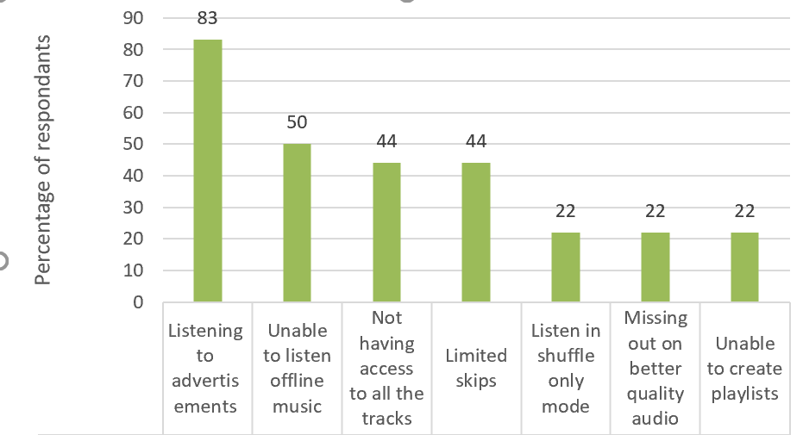
Challenges FACED In OTHER MUSIC APPS BY FREE SUBSCRIBERS
Based on customer survey results:-
Issues which bother most while listening to free music

Slide 26
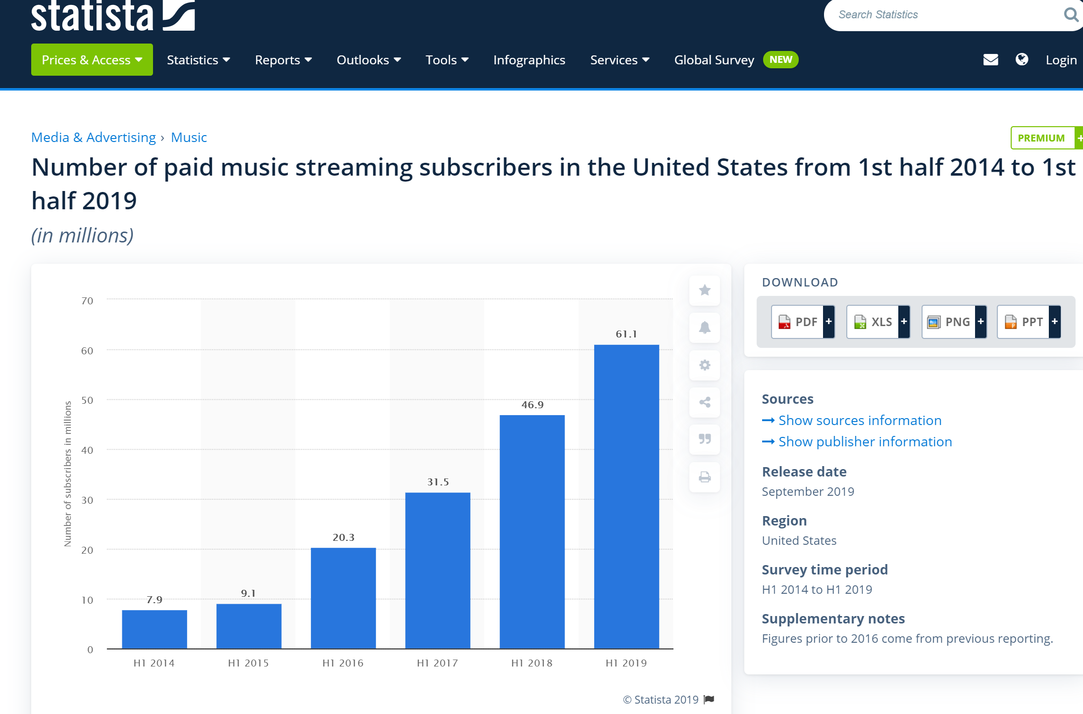
PAID MUSIC SUBSCRIBERS
(https://www.statista.com/statistics/707103/paid-streaming-music-subscribers-usa/)

Slide 27
INTERNET USERS
(https://www.statista.com/statistics/276445/number-of-internet-users-in-the-united-states/)

Slide 28
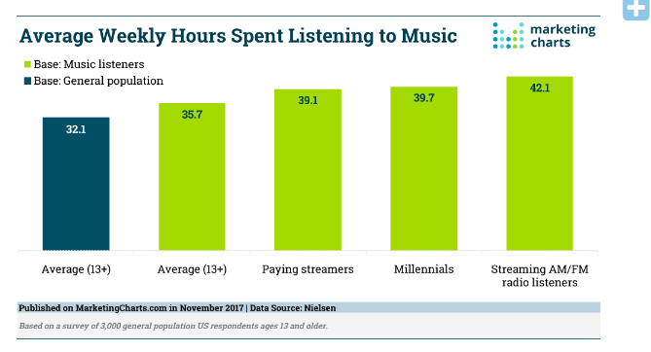
WEEKLY HOURS SPENT LISTENING TO MUSIC

Slide 29
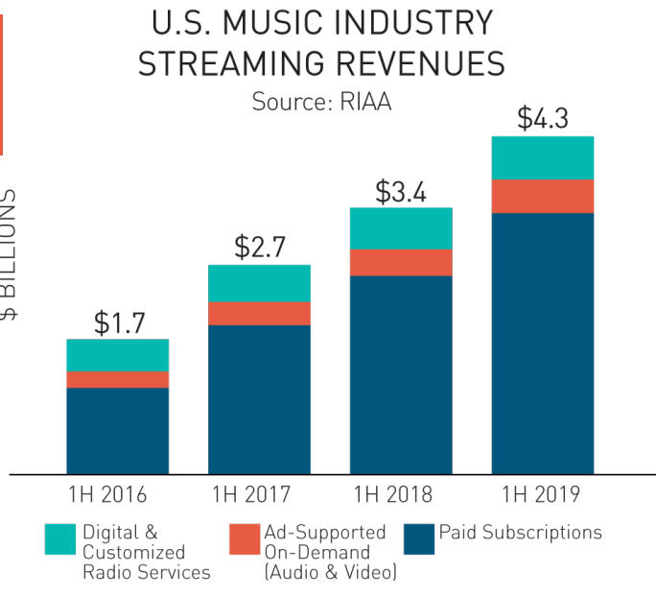
Streaming revenues in US
Paid subscriptions continued to be the biggest source of revenue for recorded music.
Paid subscriptions - 77%
Ad supported on demand – 10%
Digital & Customized Radio services – 13%
*Source: RIAA (Recording Industry Association of America)

Slide 30
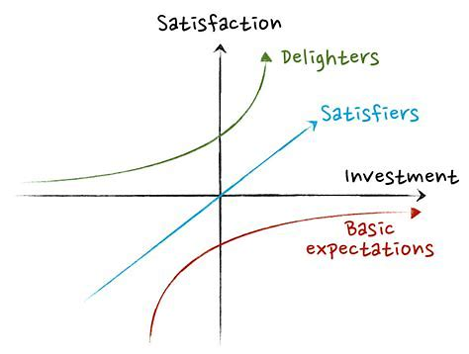
Feature SET – KANO MODEL
BASELINE:-
* Top charts, genres , moods, artists
*Able to search tracks individually
* Create playlists
* Subscribe for paid membership
* Subscription based:
Download music
Ad free
SATISFIERS:-
Recommended music
Music just for you by ML algorithms
Follow artists
Add Albums
DELIGHTERS:-
Create Musical timeline = create memories , feel nostalgia
Be able to import playlists from friends and family, so better recommendations for what to hear
Hash tagging offline music for better content management

